Slide 1
Figures-Chapter 13

Slide 2
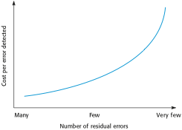
Figure 13.1 The increasing costs of residual fault removal

Slide 3
Figure 13.2 Attributes of dependable processes
Process characteristic | Description
Documentable | The process should have a defined process model that sets out the activities in the process and the documentation that is to be produced during these activities.
Standardized | A comprehensive set of software development standards covering software production and documentation should be available.
Auditable | The process should be understandable by people apart from process participants, who can check that process standards are being followed and make suggestions for process improvement.
Diverse | The process should include redundant and diverse verification and validation activities.
Robust | The process should be able to recover from failures of individual process activities.

Slide 4
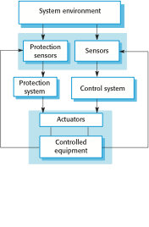
Figure 13.3 Protection system architecture

Slide 5

Figure 13.4 Self-monitoring architecture

Slide 6
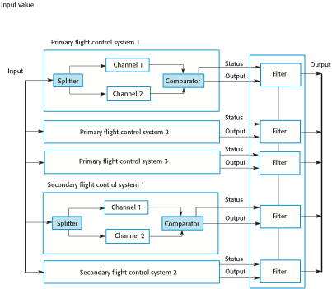
Figure 13.5 Airbus flight control system architecture

Slide 7
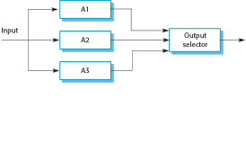
Figure 13.6 Triple modular redundancy

Slide 8
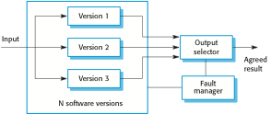
Figure 13.7 N-version programming

Slide 9
Figure 13.8 Good practice guidelines for dependable programming
Dependable programming guidelines 1. Limit the visibility of information in a program 2. Check all inputs for validity 3. Provide a handler for all exceptions 4. Minimize the use of error-prone constructs 5. Provide restart capabilities 6. Check array bounds 7. Include timeouts when calling external components 8. Name all constants that represent real-world values

Slide 10
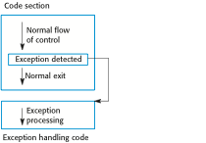
Figure 13.9 Exception handling

